Slide 1

Site Traffic Prediction
Rastin Maleki

Slide 2
Presentation Contents
Overview Of The Project and Business Goals
A Summary of The Work I Undertook
Data Validation
Exploratory Analysis
Model Deployment
Model Evaluation
Key Findings Including the Metric to Monitor and Current Estimation
Recommendations to the Business

Slide 3
Business Goals
Predict which recipes will lead to high traffic?
Achieving 80% accuracy? (I achived 80.5%)
The most important features affecting our model’s predictions?

Slide 4
A Summary of the work I undertook
Data Validation
EDA
Model Development
Model Evaluation

Slide 5
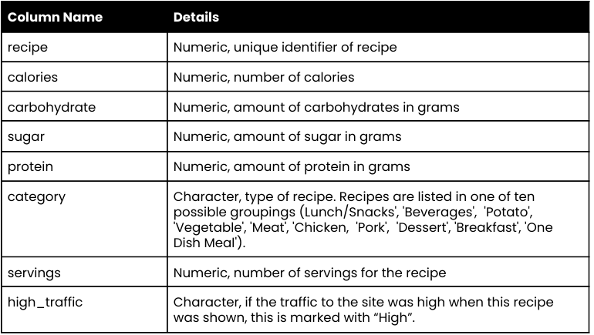
A Summary of the work I undertook: Data Validation 1/4
We need to check if our dataset matches the provided description.
Duplicated values in Index
Negative values
Type conversion
Unique values of categorial columns
Misspelled and Bad Input
Null Values
Notes:
Sometimes null values can mean something

Slide 6
A Summary of the work I undertook: Data Validation 2/4
recipe: Ensured that there are no duplicates and set it as index.
calories: Checked for negative values and will fill Null Values.
carbohydrate: Checked for negative values and will fill Null Values.
sugar: Checked for negative values and will fill Null Values.
protein: Checked for negative values and will fill Null Values.
category: Replaced 'Chicken Breast' with 'Chicken' and converted the column to category type.
servings: Converted "4 as a snack" and "6 as a snack" to 4 and 6 respectively; converted column to numeric values.
high_traffic: Replaced "High" and NaN with True and False respectively, thus converting the column to boolean.
Notes:
**Data Validation:** As part of my work, I first validated the data to prepare our dataset for further analysis and model training. This involved ensuring there were no duplicates in the index and checking for negative values in the sub-ingredient columns. I replaced "chicken breast" with "chicken" in the category column and corrected the servings column by converting "4 added snack" and "6 as a snack" to "4" and "6," respectively. Additionally, I modified the high traffic column by replacing "high" and null values with "true" and "false," converting the column to a Boolean format. I also managed null values in model developement.

Slide 7
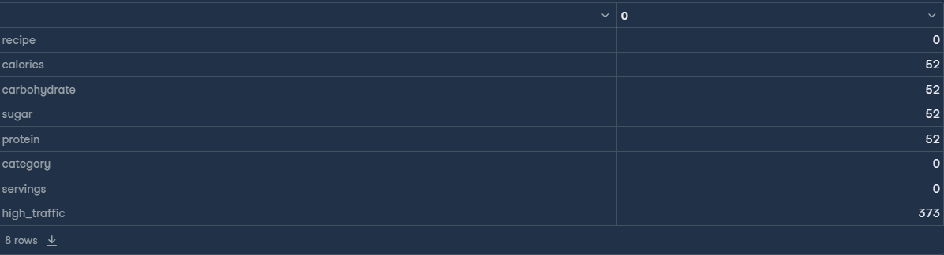
A Summary of the work I undertook: Data Validation 3/4
The null values in high_traffic represent False. Null values in calories, carbohydrate, sugar, protein need to be filled.

Slide 8
A Summary of the work I undertook: Data Validation 4/4
IT'S IMPORTANT THAT WE SHOULD NOT REPLACE NULL VALUES BASED ON THE METRICS OF ENTIRE DATASET
Scaling and Null values replacement should be done based on the metrics of train data, not entire data set. This is to avoid data leakage.
We want our final predictions to be done on truly unseen data.
That's why I'll address this problem right before training my model.

Slide 9
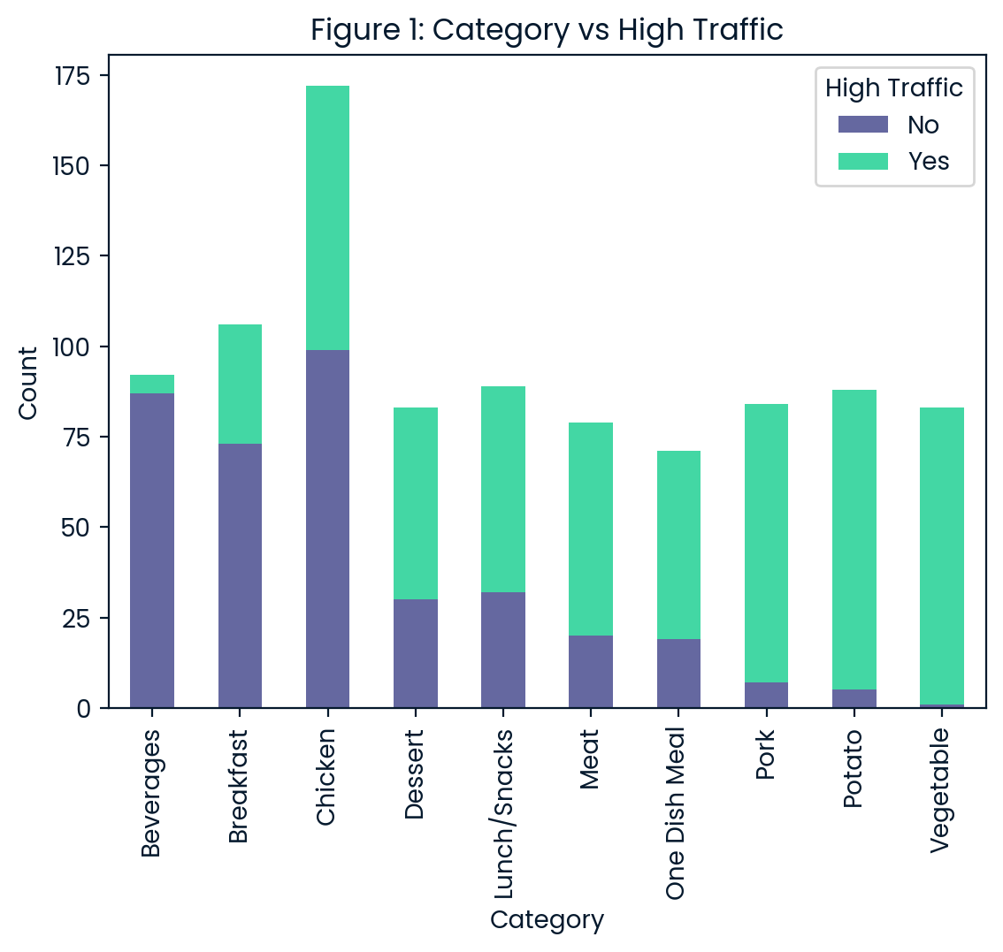
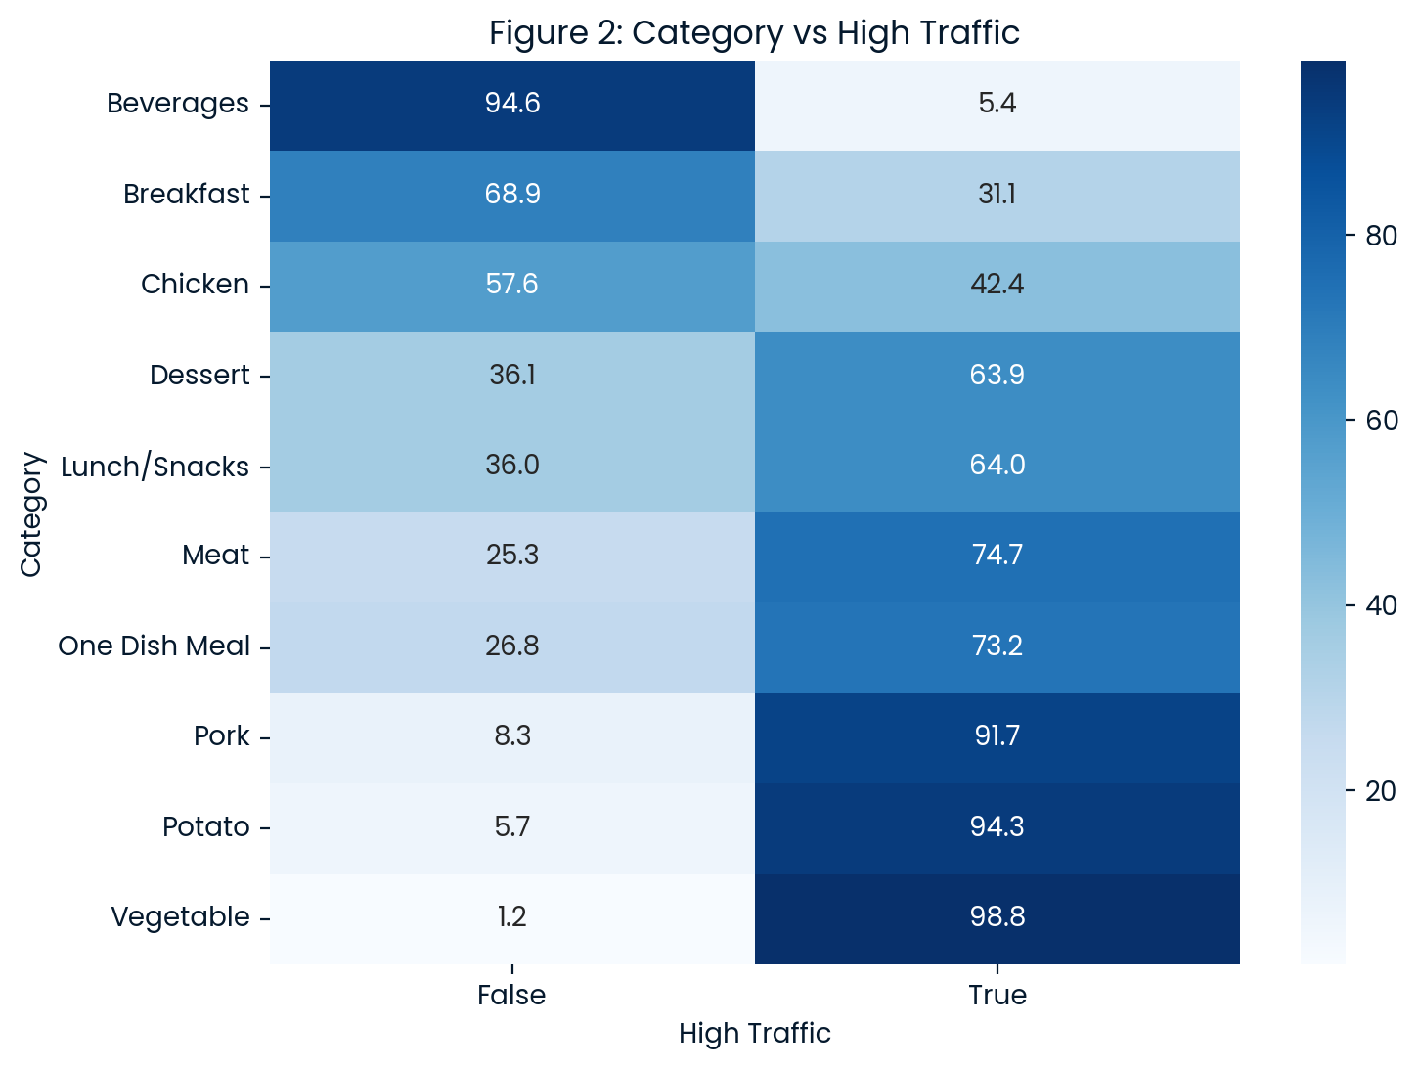
A Summary of the work I undertook: EDA 1/4
Category is the most important and affective features based on Figure 1 and 2.
Notes:
Let’s explore the data using appropriate charts and plots to gain insights into potential predictions and to identify important features for further evaluation.

Slide 10
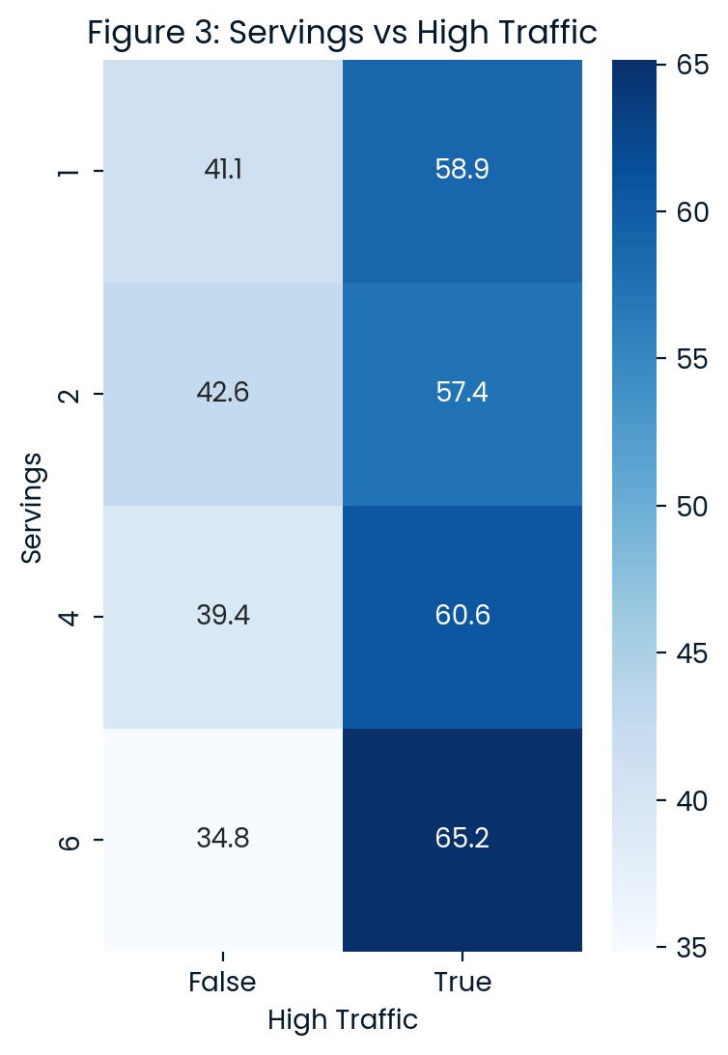
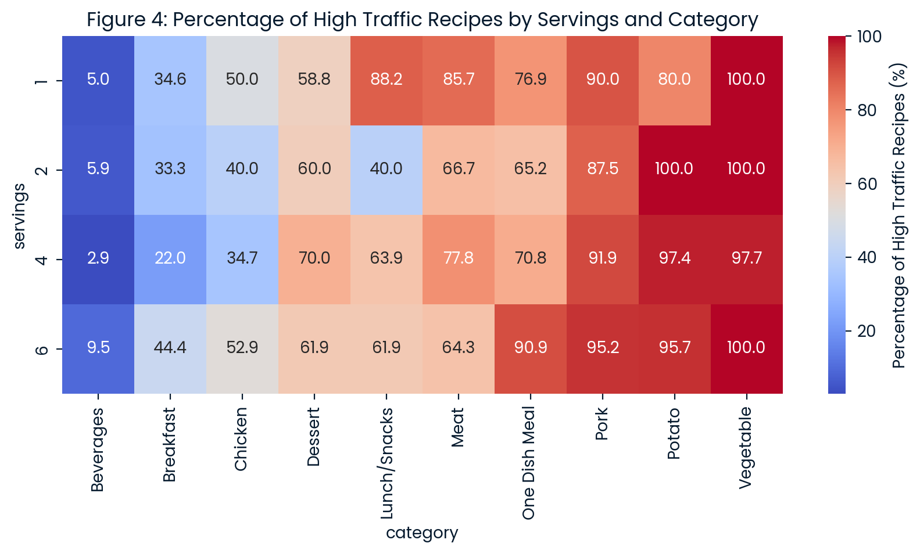
A Summary of the work I undertook: EDA 2/4
Figure 3 shows which categories accrue the most traffic for the website based on the number of servings.
Figure 4 shows which categories accrue the most traffic for the website based on the number of servings.

Slide 11
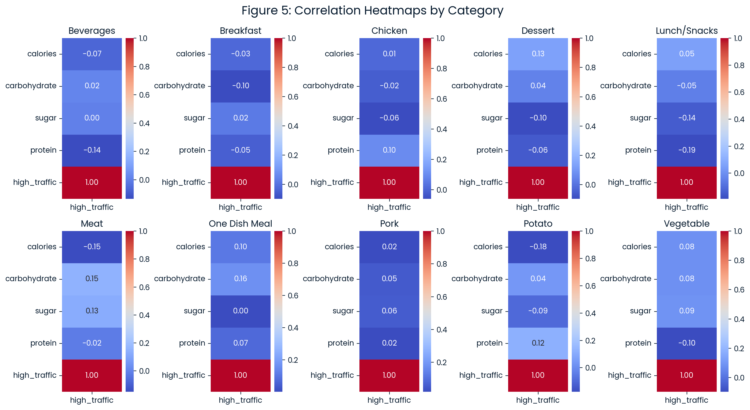
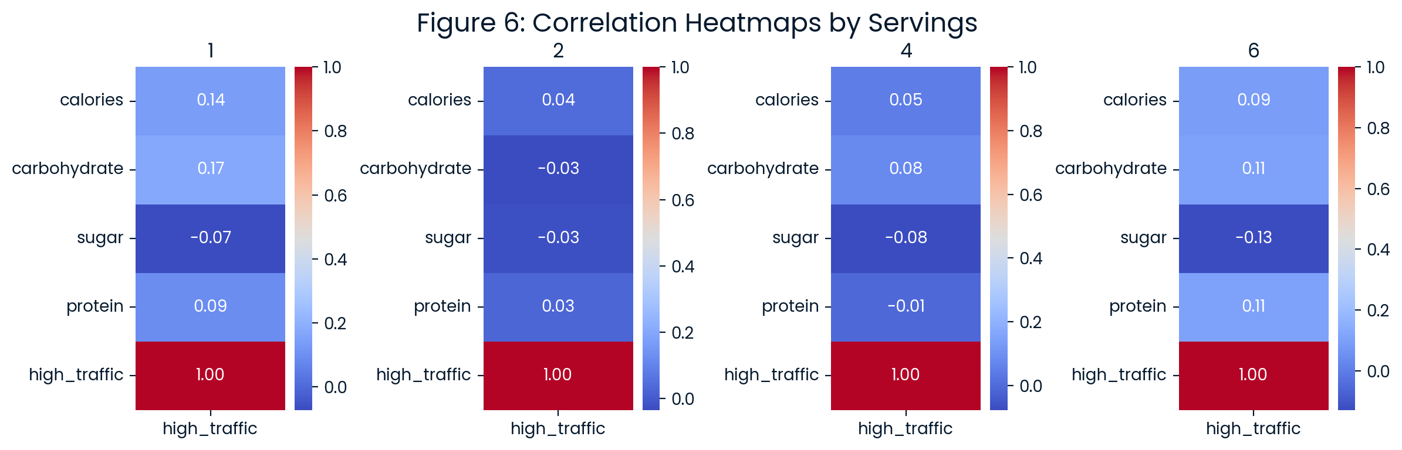
A Summary of the work I undertook: EDA 3/4
Figure 5 , 7 indicate that the ingredients have almost no affect on wether the size has high traffic or not, even when catagorized by servings or category.

Slide 12
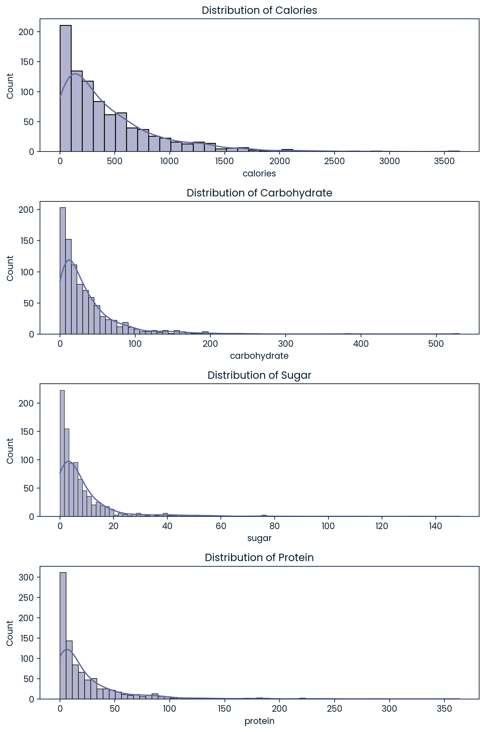
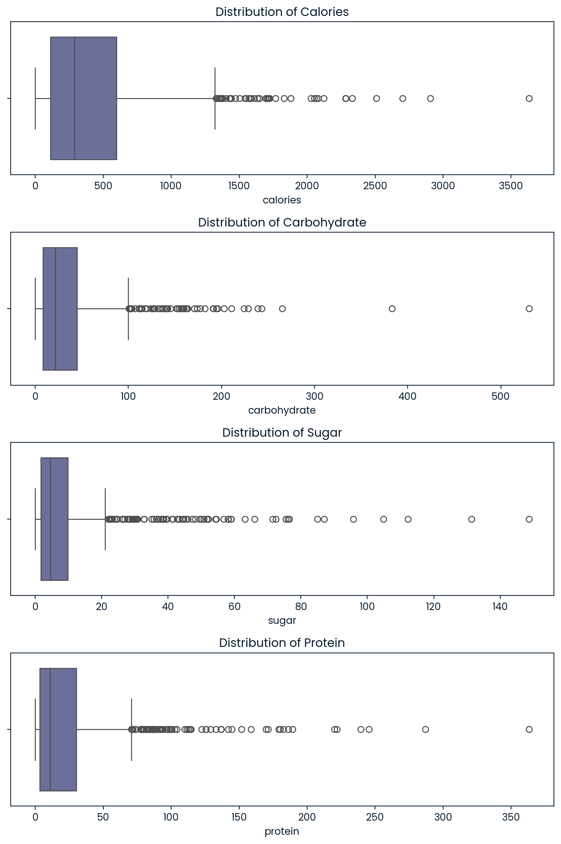
A Summary of the work I undertook: EDA 4/4
These two figures represent that the distribution of sub-ingredients are highly skewed.
So the median is a proper choice for filling null values rather than mean

Slide 13
A Summary of the work I undertook: Model Development 1/3
First:
1. Features and Labels Separation: Predictor variables are assigned to a variable X whereas the target variable "high_traffic" is assigned to a variable y.
2. Train/Test: The dataset is fractioned into a training and validation set.
Then, for each Round of CV, this process should be followed:
1. Filling Nulls: Replacing each null value with the median value of each column grouped by category.
2. Scaling: I'll use standard scaler to scale my data as it is necessary for algorithms such as KNN.
3. One-Hot Coding: Category column need to be converted to one-hot format.
4. Train: training the model.

Slide 14
A Summary of the work I undertook: Model Development 2/3
I used GridSearchCV to find the best parameters
I used KNN and Logistic Regression
I used pipeline to automize the preprocessing
Scoring metrics: ROC curve
KNN
Best Score: 0.8106323444346717
Best Score: {'knn__leaf_size’: 40, 'knn__n_neighbors': 40, 'knn__weights': 'uniform’}
LR
Best Score: 0.8170619884153059
Best Score: {'lr__C': 0.01, 'lr__max_iter': 50, 'lr__penalty': 'l2'}
Notes:
I then developed a prediction model to determine whether a recipe would generate high traffic. I chose the parameters of my model by cross-validating different hyperparameters. To accomplish this, I utilized Grid Search CV, which systematically explored all the hyperparameters I provided as input. This process enabled me to identify the optimal hyperparameters that resulted in the highest ROC accuracy.
I used a pipeline object to automate the processes of imputing, one-hot encoding, and scaling for each set of cross-validation. It is crucial that we avoid imputing null values at the beginning of exploration, as no metrics from the test data should leak into our training data. Therefore, we should not scale or fill null values using metrics such as the mean, median, minimum, or maximum of the entire dataset, which includes the test data. This practice ensures accurate evaluations on truly unseen data and maintains the integrity of our model's performance assessment.

Slide 15
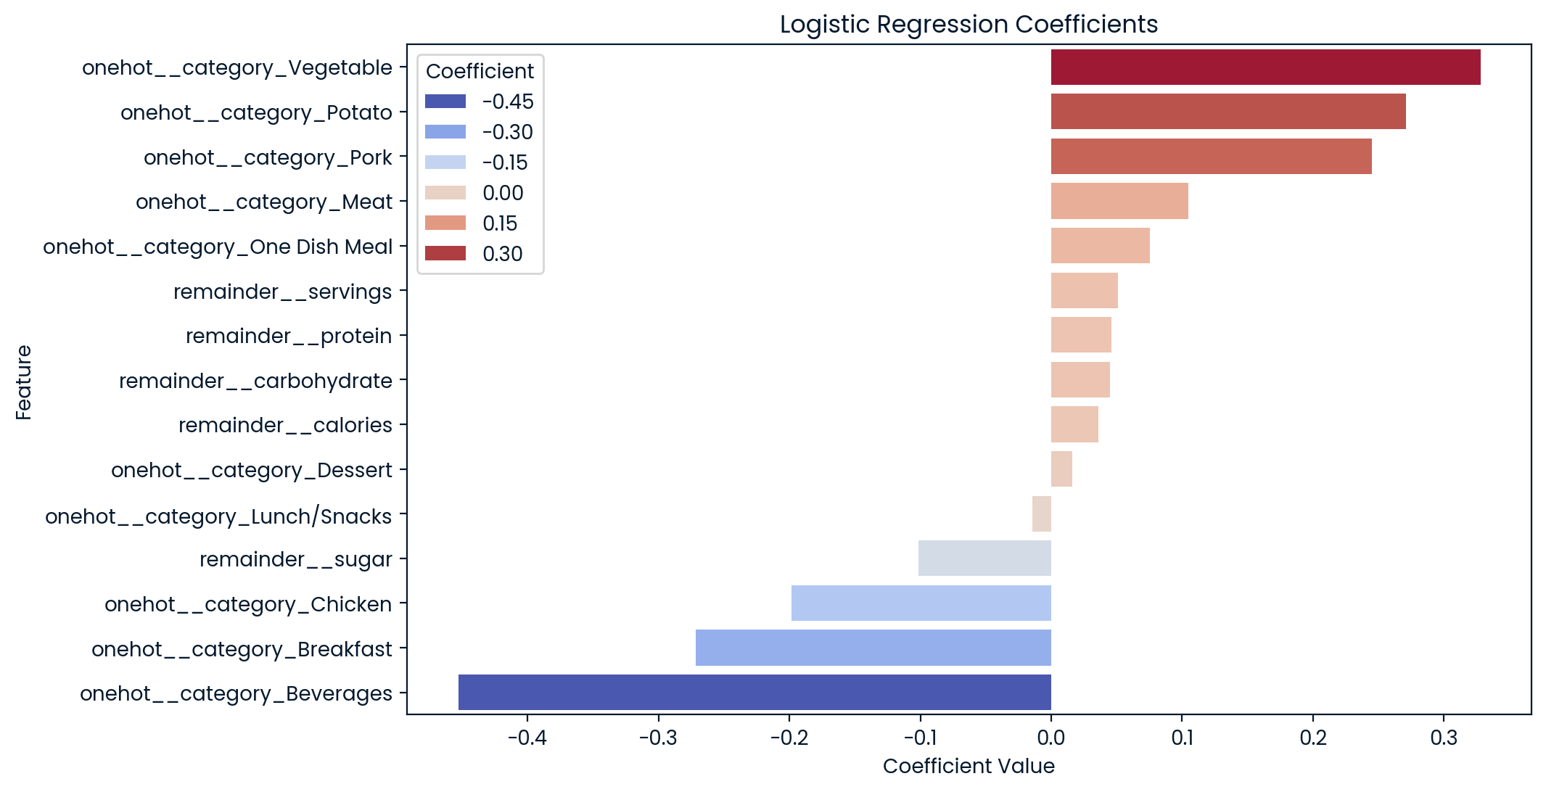
A Summary of the work I undertook: Model Development 3/3
Notes:
Altough we found out KNN has performed better, it gives us a good insight of our feature importance by taking a look at the feature importances in Logistic Regression. It was revealed that the most important features identified by the model were the categorical columns, while sub-ingredients provided little informative value regarding high traffic outcomes, as I had expected during the exploratory data analysis (EDA).

Slide 16
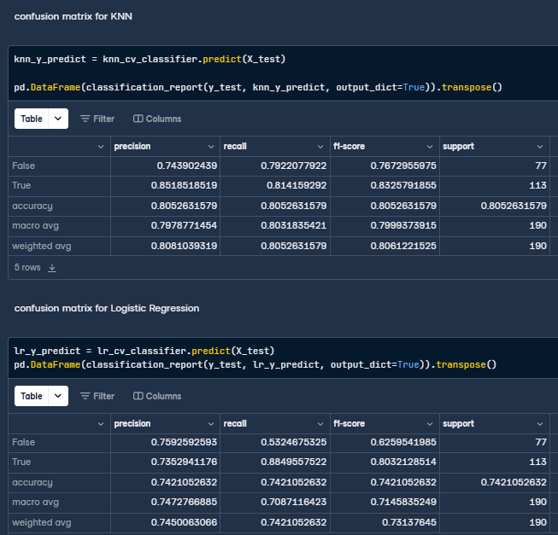
A Summary of the work I undertook: Model Evaluation 1/2

Slide 17
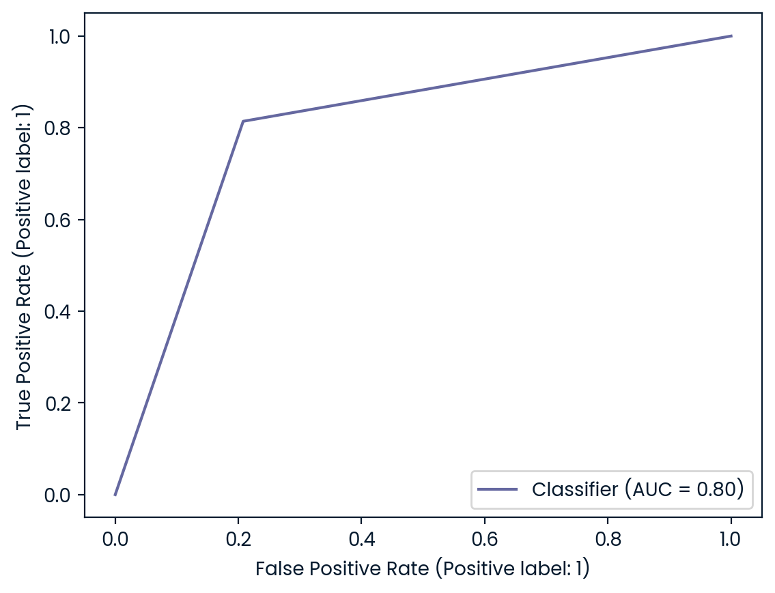
A Summary of the work I undertook: Model Evaluation 2/2

Slide 18
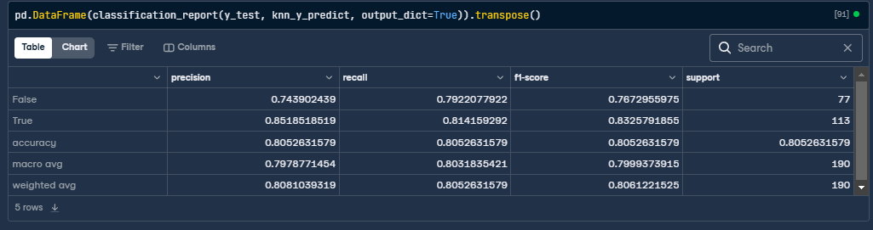
Key Findings Including the Metric to Monitor and Current Estimation 1/2
The model performs better in predicting the True class than the False class, as indicated by the higher precision and recall scores for True.
There is some imbalance in performance between the two classes, suggesting that further model tuning or the use of techniques like class weighting or oversampling the minority class could improve overall predictive performance.
Notes:
Lastly, I evaluated the model by making predictions on the test data and reporting its performance as the final assessment. This evaluation marks the conclusion of the model training process, and I will not conduct any further training on this model. Based on the F1 score for true and false predictions, I concluded that a KNN model was the most effective choice.

Slide 19
Key Findings Including the Metric to Monitor and Current Estimation 2/2
The model has a reasonable overall accuracy of 80.5%, but you may want to explore strategies to enhance the identification of the False class to reduce misclassifications.
To improve overall accuracy, we could consider preparing a larger dataset, which would provide more diverse examples for the model to learn from. Additionally, utilizing more sophisticated machine learning models, such as neural networks, may enhance our predictions.

Slide 20
Recommendations to the Business
Given these findings, I recommend going with the KNN model for better performance and use the mentioned hyperparameter settings.
I also recommend that for future predictions, we focus on tracking only the category of a recipe, as it is the most significant and effective feature for our model to train on. Training the model on less important data only complicates and slows the training process and does not add much performance to our model.

